Slide 1
Replaying Archived Twitter:
When your bird is broken, will it bring you down?
By Kritika Garg, Himarsha Jayanetti, Sawood Alam,
Michele C. Weigle, and Michael L. Nelson
Presented by Emily Escamilla
CS 895: Web Archiving Forensics
October 24, 2022

Slide 2
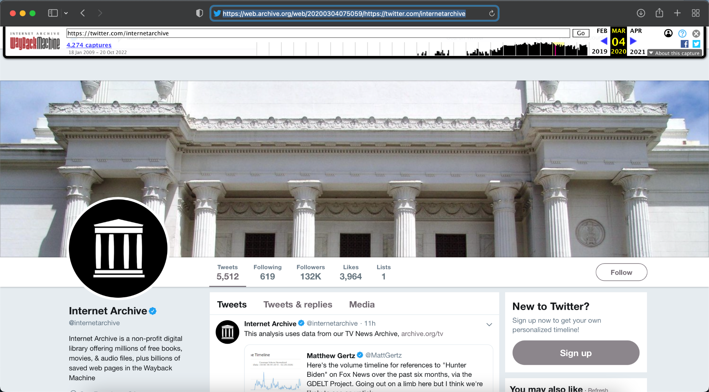
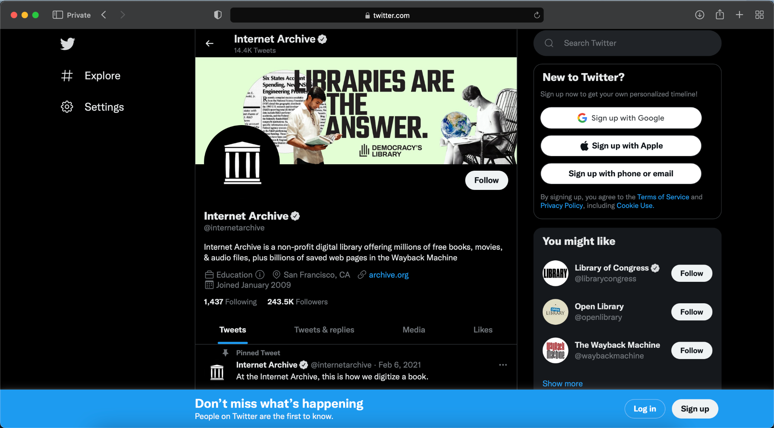
Twitter fully implemented a new UI June 1, 2020
https://web.archive.org/web/20200304075059/https://twitter.com/internetarchive
https://twitter.com/internetarchive on Oct. 20, 2022

Slide 3
Twitter implemented a new UI June 1, 2022
https://web.archive.org/web/20200304075059/https://twitter.com/internetarchive
https://twitter.com/internetarchive on Oct. 20, 2022

Slide 4
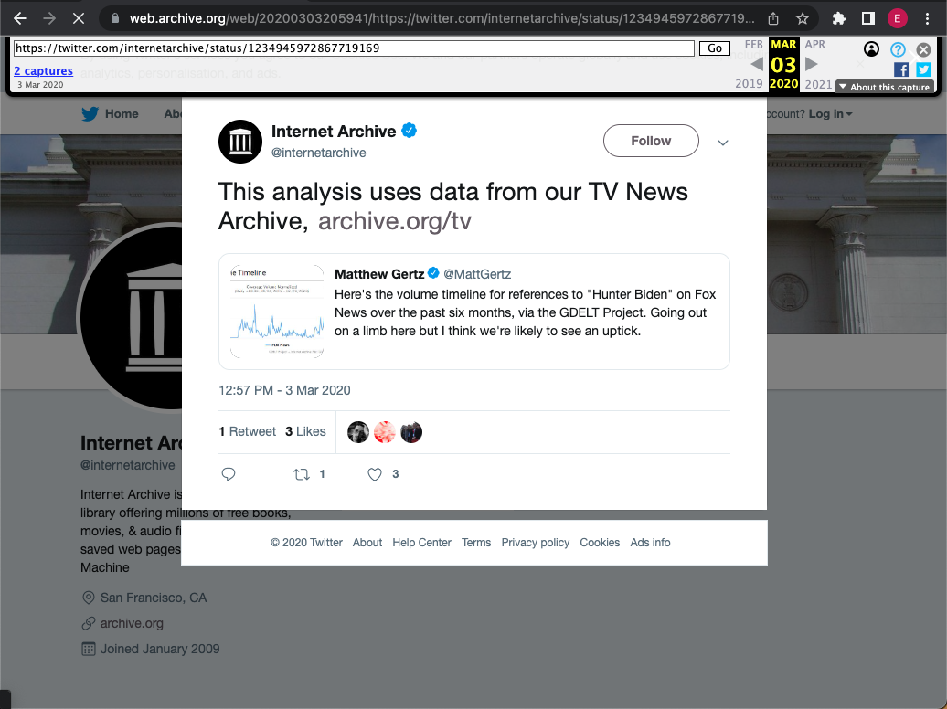
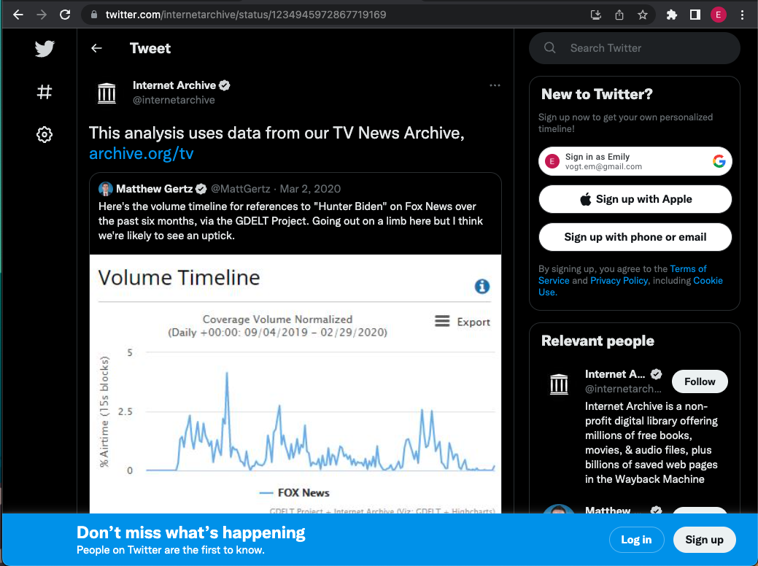
Tweet pages also have a new UI
https://web.archive.org/web/20200303205941/https://twitter.com/internetarchive/status/1234945972867719169
https://twitter.com/internetarchive/status/1234945972867719169
on Oct. 24, 2022

Slide 5
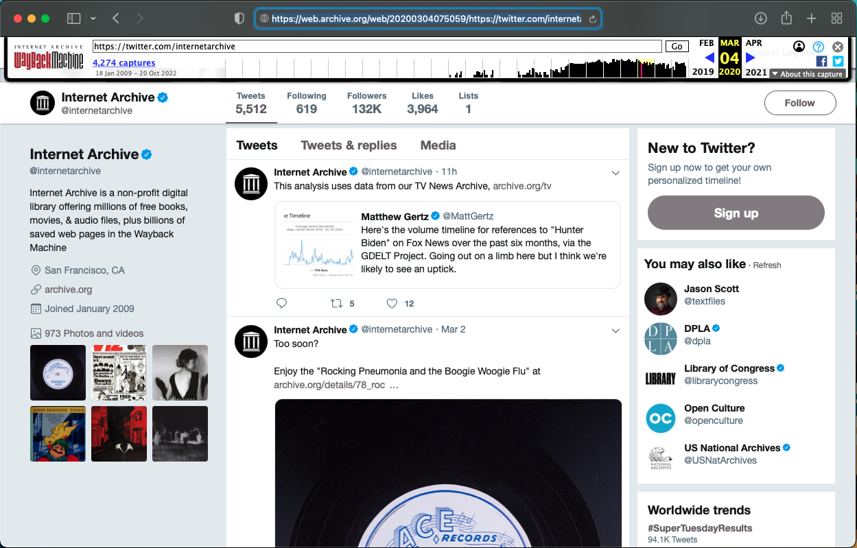
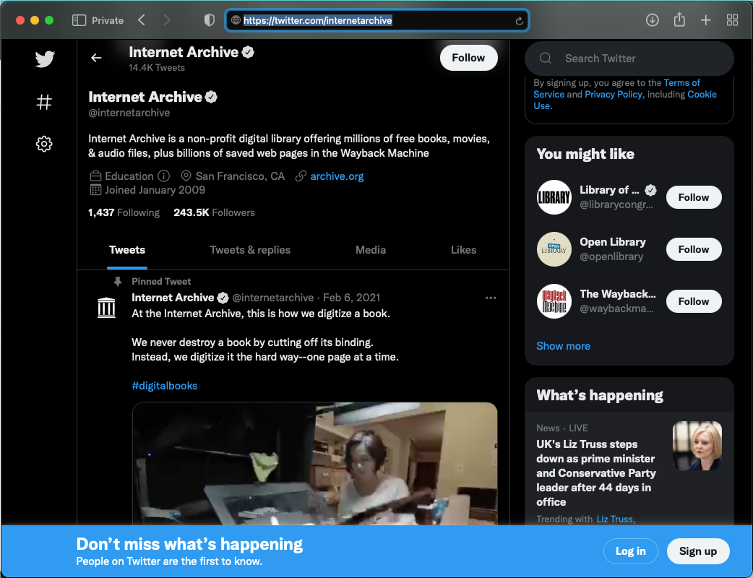
Twitter UI Changes are Bigger than Appearance
Dynamically Loaded
https://web.archive.org/web/20200304075059/https://twitter.com/internetarchive
https://twitter.com/internetarchive on Oct. 20, 2022

Slide 6
Tweets are Now Dynamically Loaded
Included in the root HTML
https://web.archive.org/web/20200304075059/https://twitter.com/internetarchive
https://twitter.com/internetarchive on Oct. 20, 2022

Slide 7
Can Twitter mementos be used to accurately replay tweets from @realDonaldTrump’s deleted account?

Slide 8
Twitter Mementos do not always match the live Web
Old UI vs New UI Mementos
Labels
Temporal Violations

Slide 9
93.3% of @realDonaldTrump URI-Ms are Old UI Mementos
8,709 unique tweets from May 1, 2020 - Jan 8, 2021
1,517,024 ‘200 OK’ URI-Ms
64,364 account URI-Ms
1,259,999 tweet URI-Ms
3,615 new UI
60,749 old UI
84,782 new UI
1,175,217 old UI

Slide 10
93.3% of @realDonaldTrump URI-Ms are Old UI Mementos
8,709 unique tweets from May 1, 2020 - Jan 8, 2021
1,517,024 ‘200 OK’ URI-Ms
Old UI mementos do not reflect the live Web users saw
64,364 account URI-Ms
1,259,999 tweet URI-Ms
3,615 new UI
60,749 old UI
84,782 new UI
1,175,217 old UI

Slide 11
Twitter Mementos do not always match the live Web
Old UI vs New UI Mementos
Labels
Temporal Violations

Slide 12
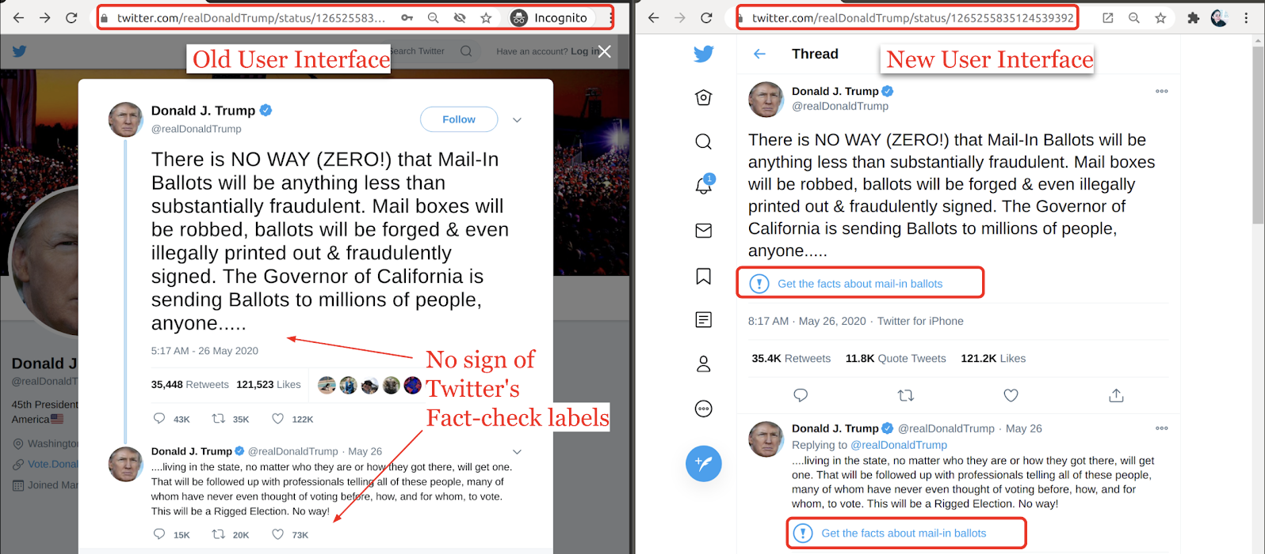
Twitter’s New UI includes Tweet Labels
Figure 1

Slide 13
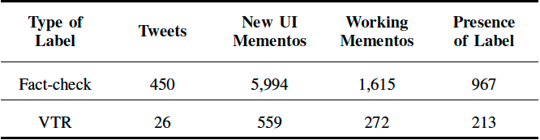
Are Labels Reflected in Mementos?
Table VIII
VTR: Violated Twitter Rules

Slide 14
Are Labels Reflected in Mementos?
Table VIII

Slide 15
Are Labels Reflected in Mementos?
Table VIII
4.88% of 122,891 URI-Ms
0.75% of 74,883 URI-Ms

Slide 16
Are Labels Reflected in Mementos?
Table VIII
1.31% of 122,891 URI-Ms
0.36% of 74,883 URI-Ms

Slide 17
Are Labels Reflected in Mementos?
Table VIII
0.79% of 122,891 URI-Ms
0.28% of 74,883 URI-Ms

Slide 18
Are Labels Reflected in Mementos?
Table VIII
0.79% of 122,891 URI-Ms
0.28% of 74,883 URI-Ms
A small percentage of URI-Ms accurately reflected the labels shown on the live Web

Slide 19
Twitter Mementos do not always match the live Web
Old UI vs New UI Mementos
Labels
Temporal Violations

Slide 20
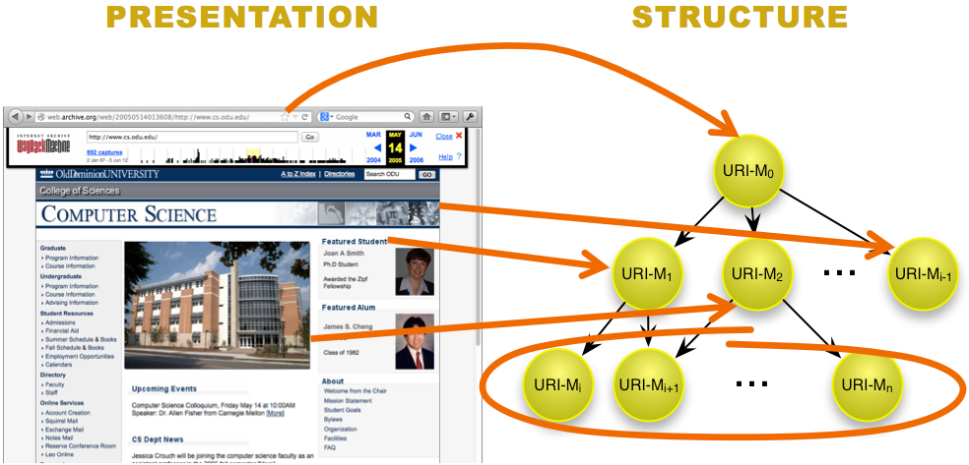
What are Temporal Violations?
Incorrectly combined archived embedded resources + archived root page
https://ws-dl.blogspot.com/2015/12/2015-12-08-evaluating-temporal.html

Slide 21
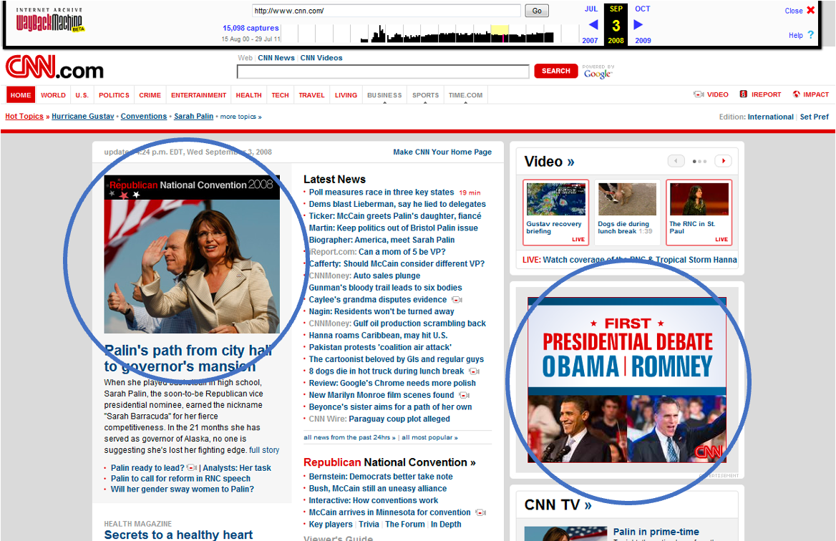
This Page Never Existed on the Live Web
Scripts in a Frame: A Framework for Archiving Deferred Representations by Dr. Justin F. Brunelle Fig 40

Slide 22
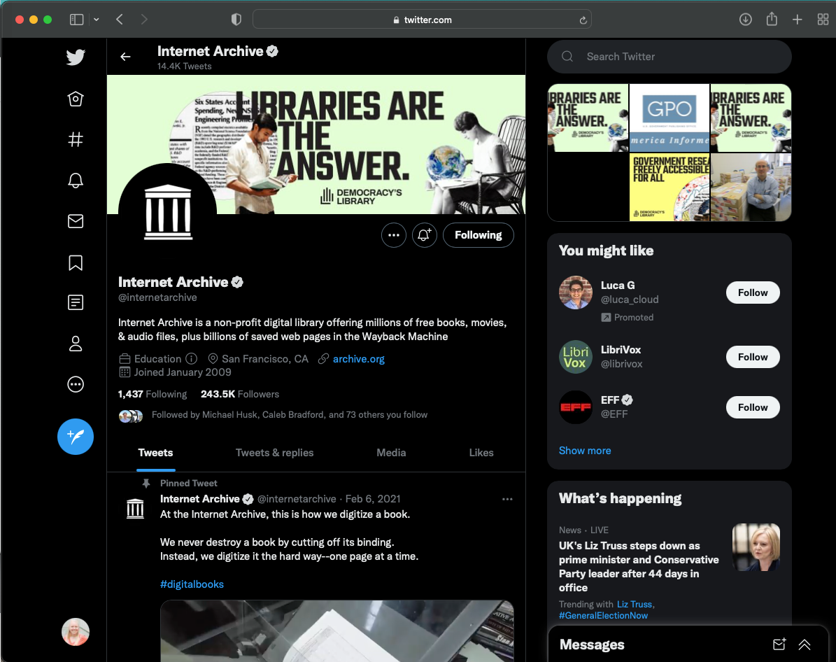
Dynamic Content Can Introduce Temporal Violations

Slide 23
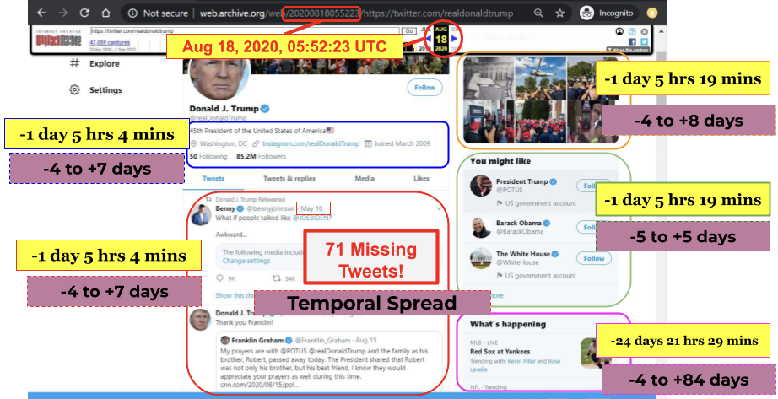
Temporal Violations can Lead to Missing Tweets
Figure 4

Slide 24
Are the Twitter Mementos Temporally Violative?
3,615 new UI account page mementos
1,825 failed new UI mementos
1,790 complete new UI mementos
48.8% were temporally violative
@realDonaldTrump tweeted frequently which increased the impact of temporal spread

Slide 25
Key Takeaways
Replay of Twitter mementos does not always match the live Web
Old UI mementos are more prominent than new UI mementos
93.3% of all mementos are old UI mementos
Old UI does not contain labels
96.69% of labeled tweet mementos were old UI mementos
New UI mementos are vulnerable to temporal violations
48.8% of complete mementos are missing 1+ tweet

